Slide 1

Information and Network Security(INS)

Slide 2
INS - Lecture 5,6 Presented by: Drashti Shrimal

Slide 3
UNIT 1: Topics in this presentation
OSI architecture - Detailed(Part 3)
- Security Mechanisms
- Types of Security Mechanisms

Slide 4
OSI architecture : Security Mechanisms
Encipherment
Digital Signature
Access Control
Data Integrity
Security Label
Event Detection
Security Audit Trail
Security Recovery
Routing Control
Notarization

Slide 5
Types of Security Mechanisms
1. Encipherment:
Converting your data into a secret code language using intelligent techniques in such a way that only the recipient of the data knows how to decipher it.
2. Digital Signature:
Digital Signature is a process that guarantees that the contents of a message have not been altered in transit. When you, the server, digitally sign a document, you add a one-way hash (encryption) of the message content using your public and private key pair.

Slide 6
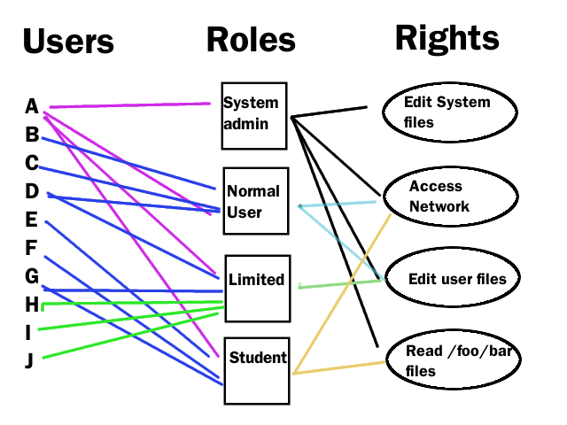
Types of Security Mechanisms
3. Access control:
Access control is a security technique that regulates who or what can view, use or access a place or other resources.

Slide 7
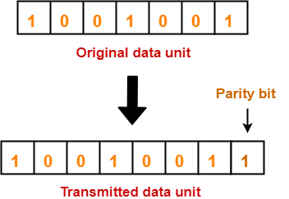
Types of Security Mechanisms
4. Data Integrity techniques:
Ex- Parity Bits

Slide 8
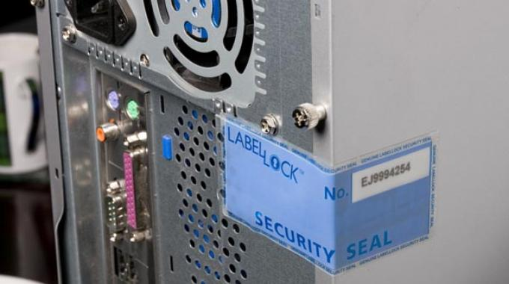
Types of Security Mechanisms
5. Security Label:
A security label is a simple, one- to eight-byte, installation-defined character string. This character string represents the union of a security level with zero or more security categories.

Slide 9
Types of Security Mechanisms
6. Event Detection:
A particular event occurs, the alert is sent to the concerned officials.
Ex- Triggers in DB
7. Security Audit Trail:
A record showing who has accessed a computer system and what operations he or she has performed during a given period of time. Audit trails are useful both for maintaining security and for recovering lost transactions.

Slide 10
Types of Security Mechanisms
8. Security Recovery:
Recovery has two forms. The first is to stop an attack and to assess and repair any damage caused by that attack. As an example, if the attacker deletes a file, one recovery mechanism would be to restore the file from backup tapes. In practice, recovery is far more complex, because the nature of each attack is unique.
In a second form of recovery, the system continues to function correctly while an attack is under way. This type of recovery is quite difficult to implement because of the complexity of computer systems.

Slide 11
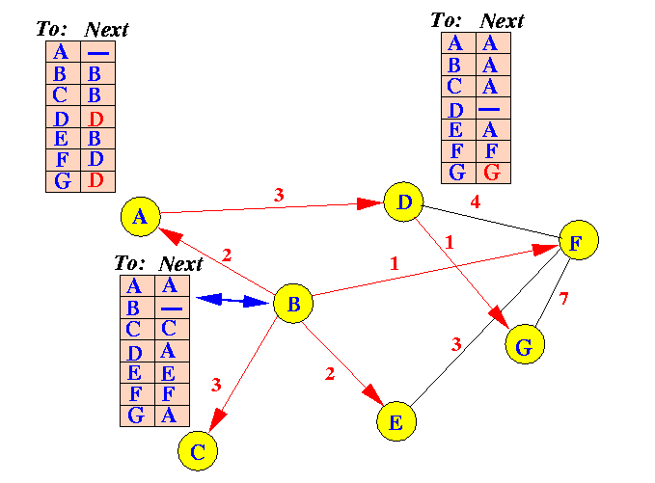
Types of Security Mechanisms
9. Routing Control:
A routing control mechanism is composed of hardware and software, which monitors all the outgoing traffic through its connection with the Internet service providers (ISPs), and helps in selecting the best path for efficient delivery of the data.

Slide 12
Types of Security Mechanisms
10. Notarization:
Notarization means selecting a third trusted party to control the communication between two entities. The receiver can involve a trusted third party to store the sender request in order to prevent the sender from later denying that she has made a request.

Slide 13
Thanks!
Any questions?
You can post your questions on Google Classroom.

